Slide 1


Control Flow Integrity
& Secure Data Flow
SE3331-1 (2023 Fall)
IPADS, Shanghai Jiao Tong University
https://www.sjtu.edu.cn
Notes:
Credits to Mike Freedman (COS 461) and others.

Slide 2
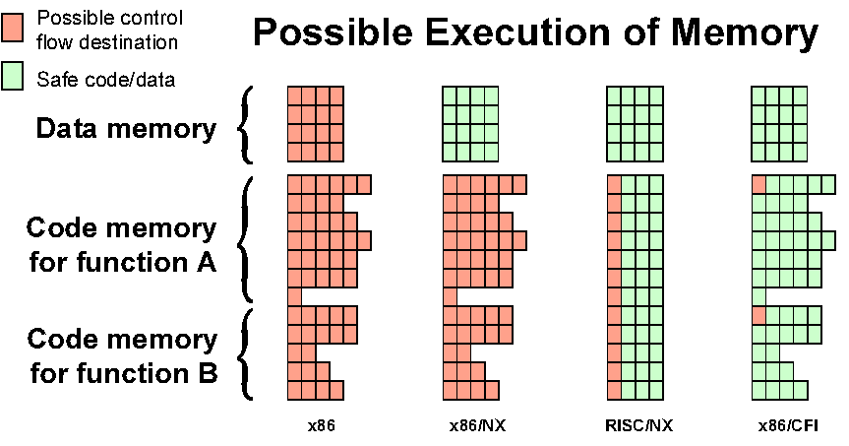
Possible Execution of Memory
[Erlingsson]

Slide 3
Blind ROP

Slide 4
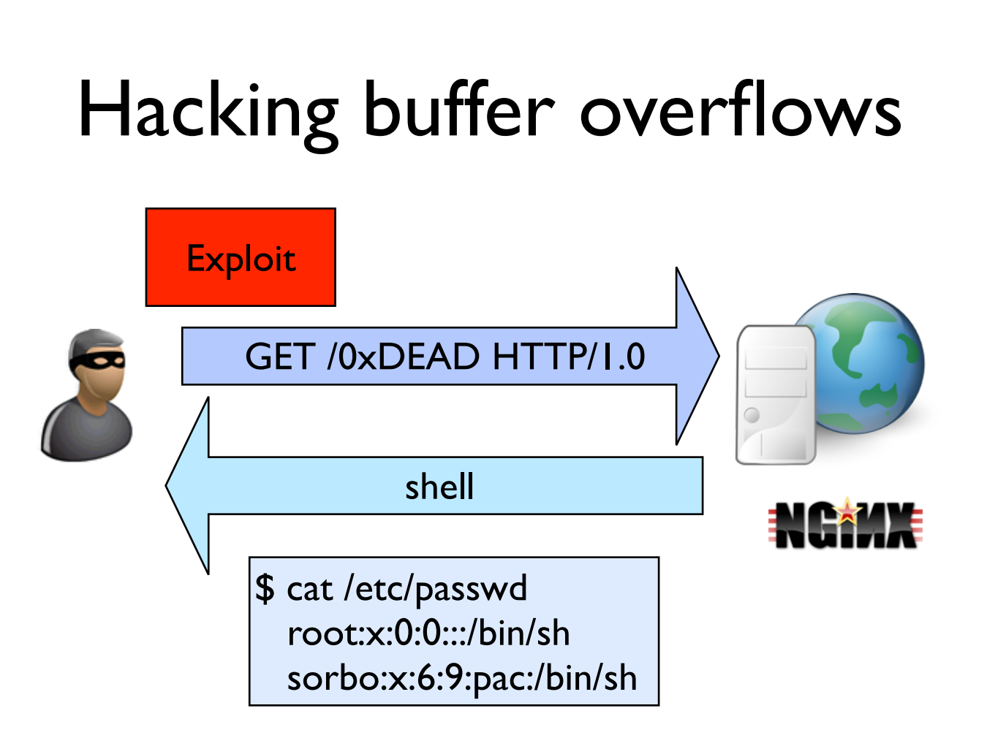

Slide 5
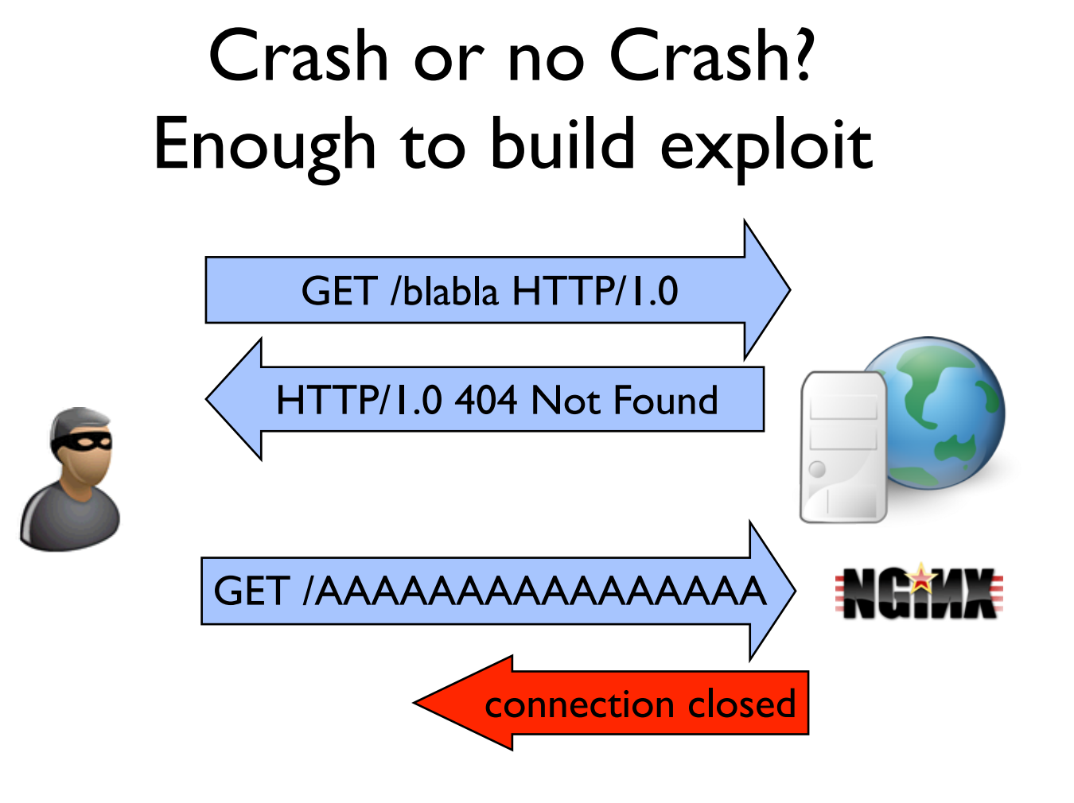

Slide 6
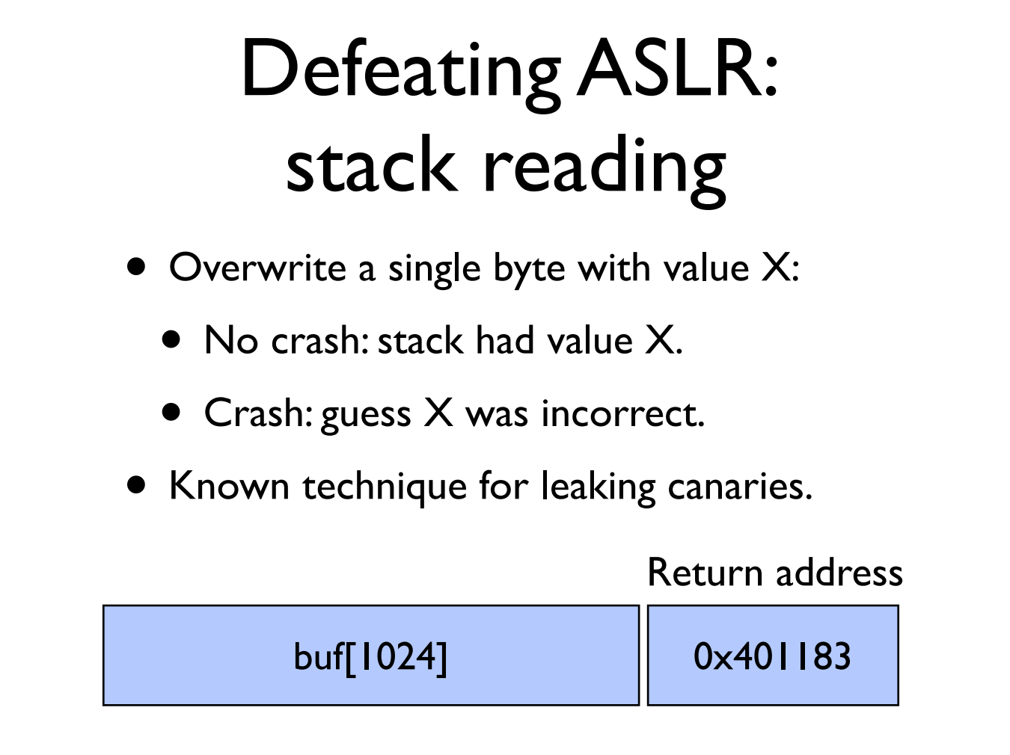

Slide 7
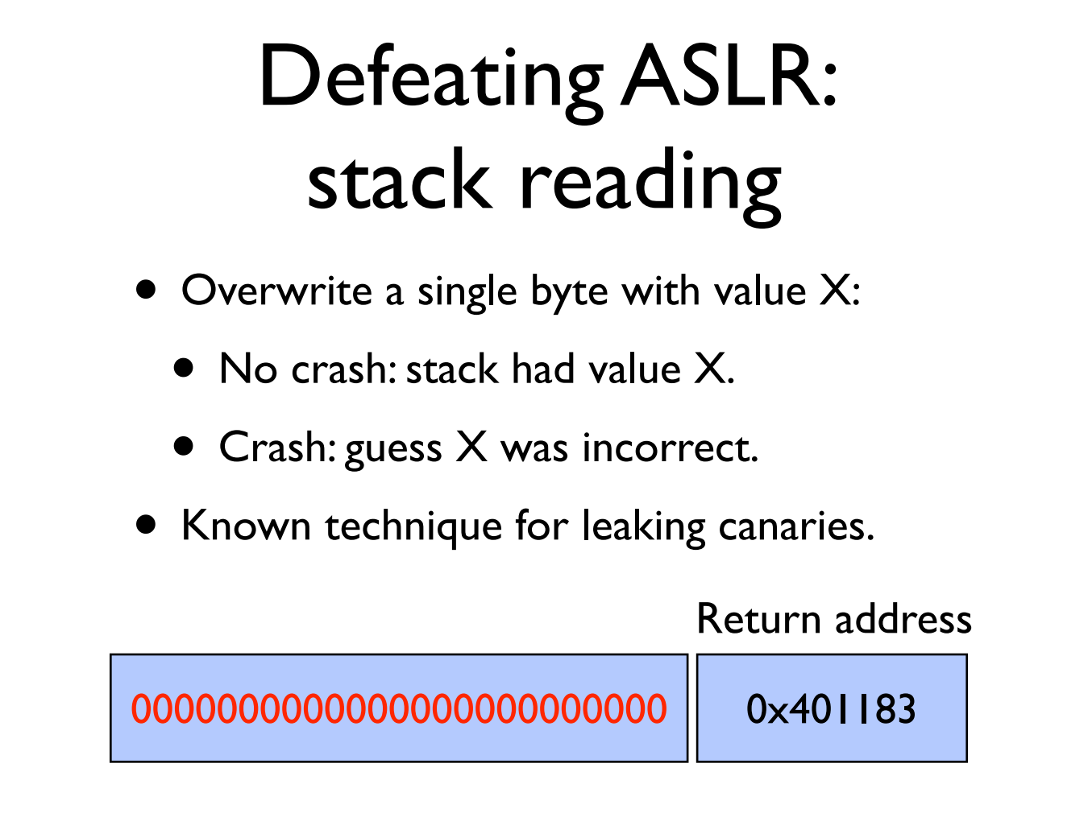

Slide 8
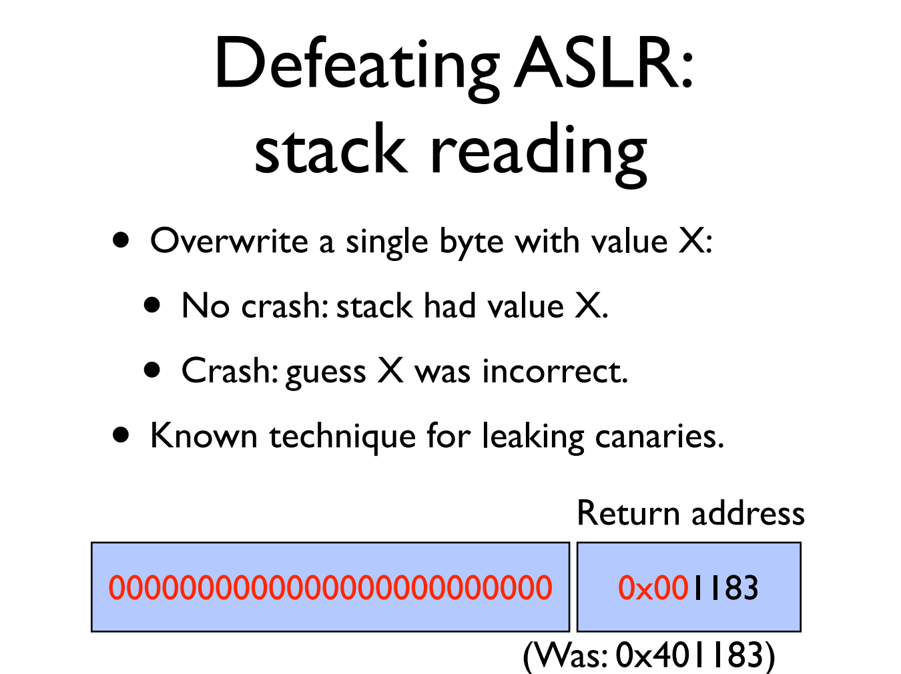

Slide 9


Slide 10


Slide 11
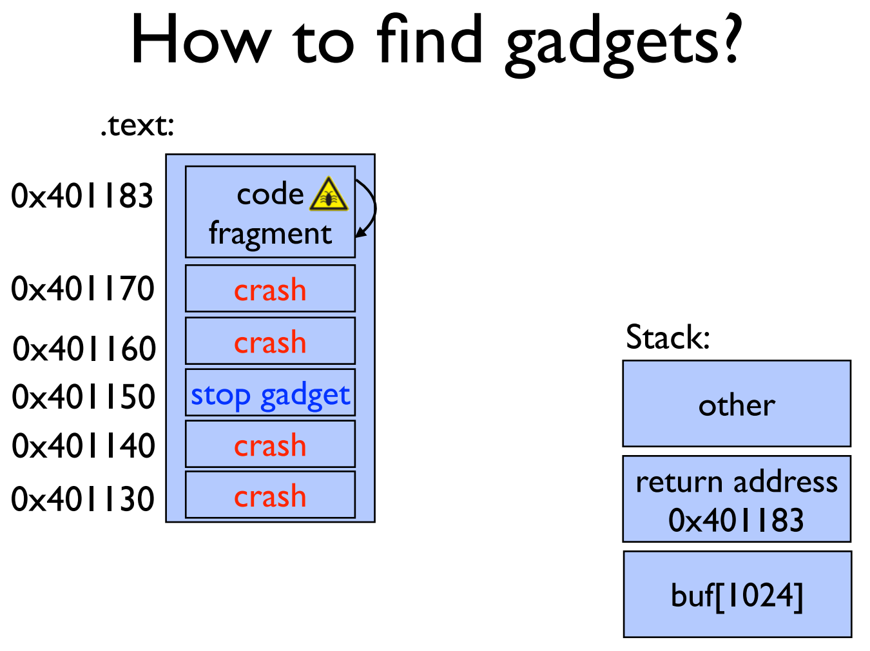

Slide 12
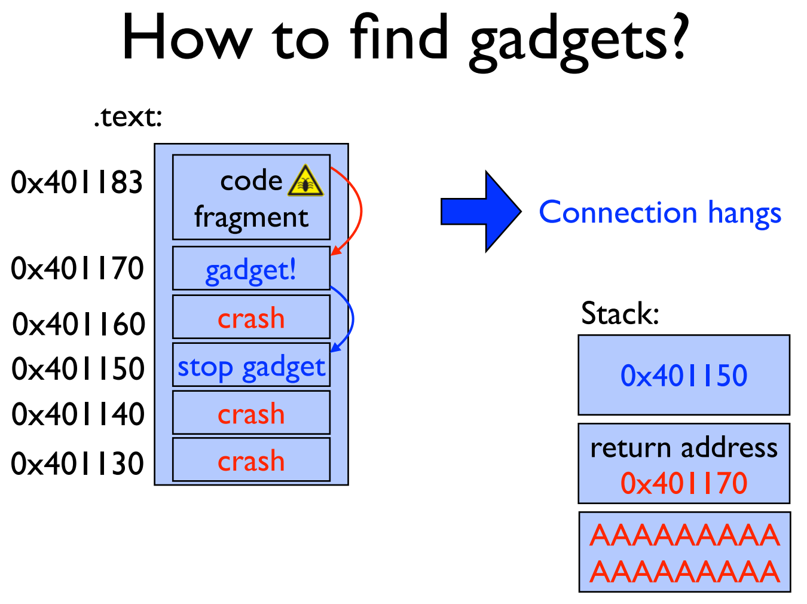

Slide 13
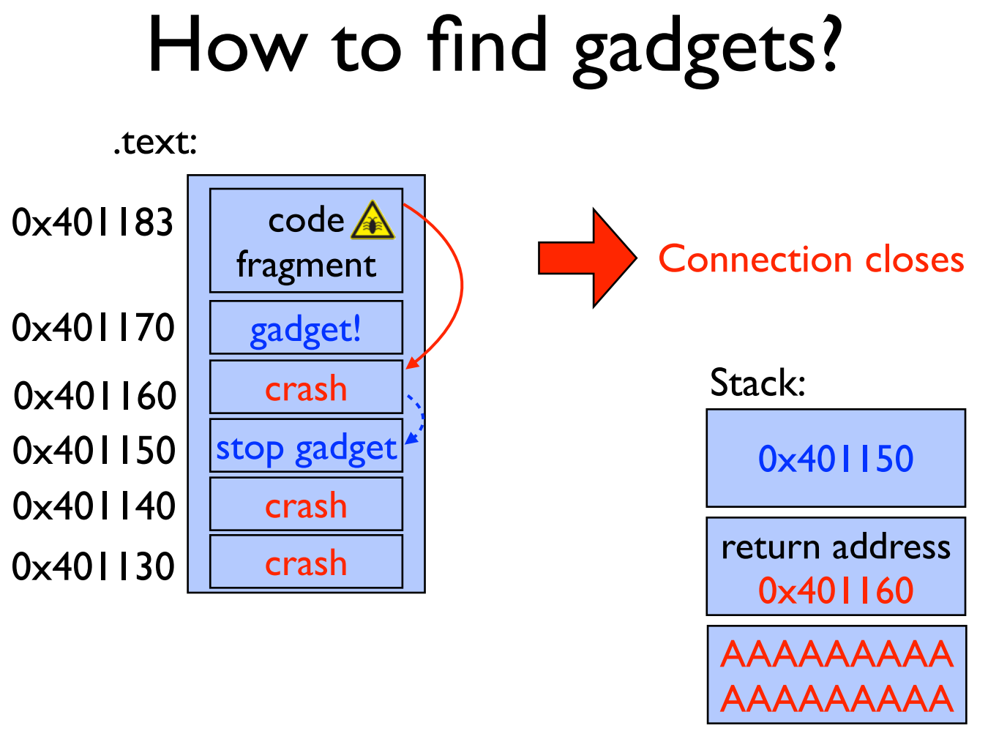

Slide 14
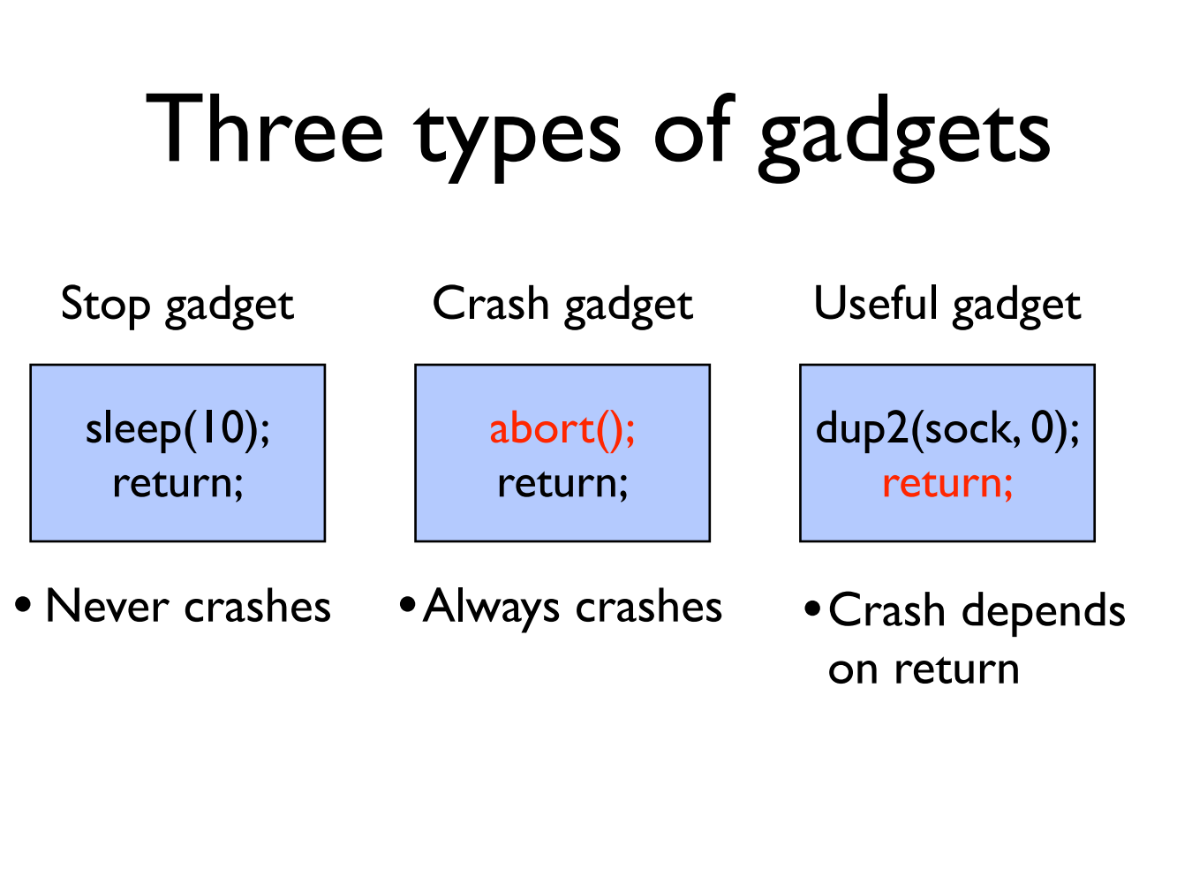

Slide 15
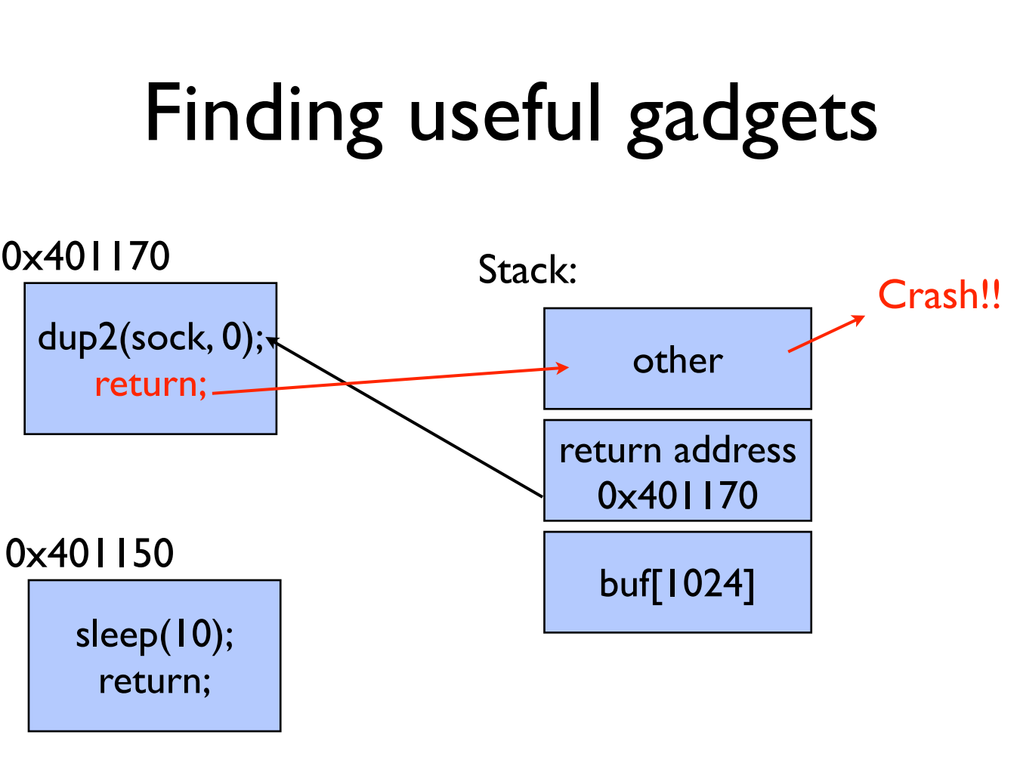

Slide 16
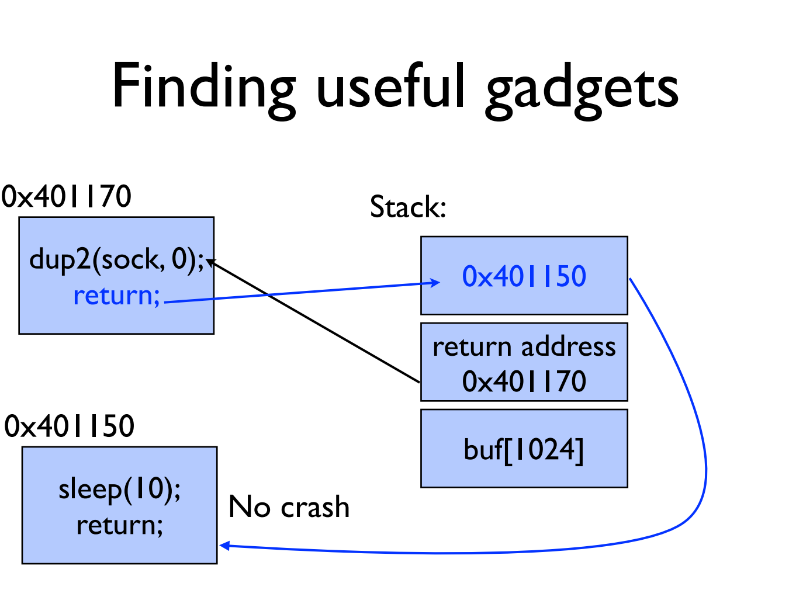

Slide 17
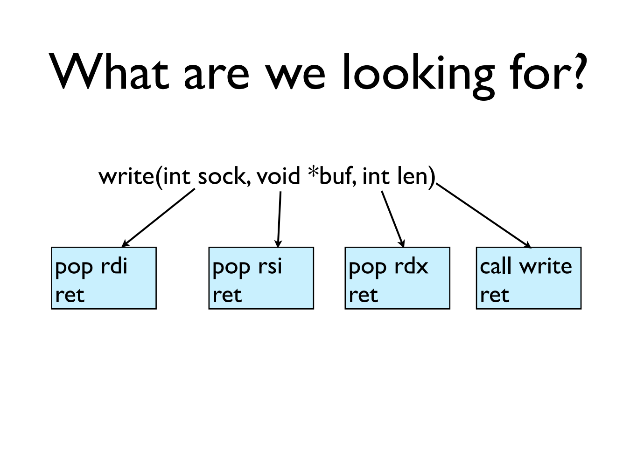

Slide 18
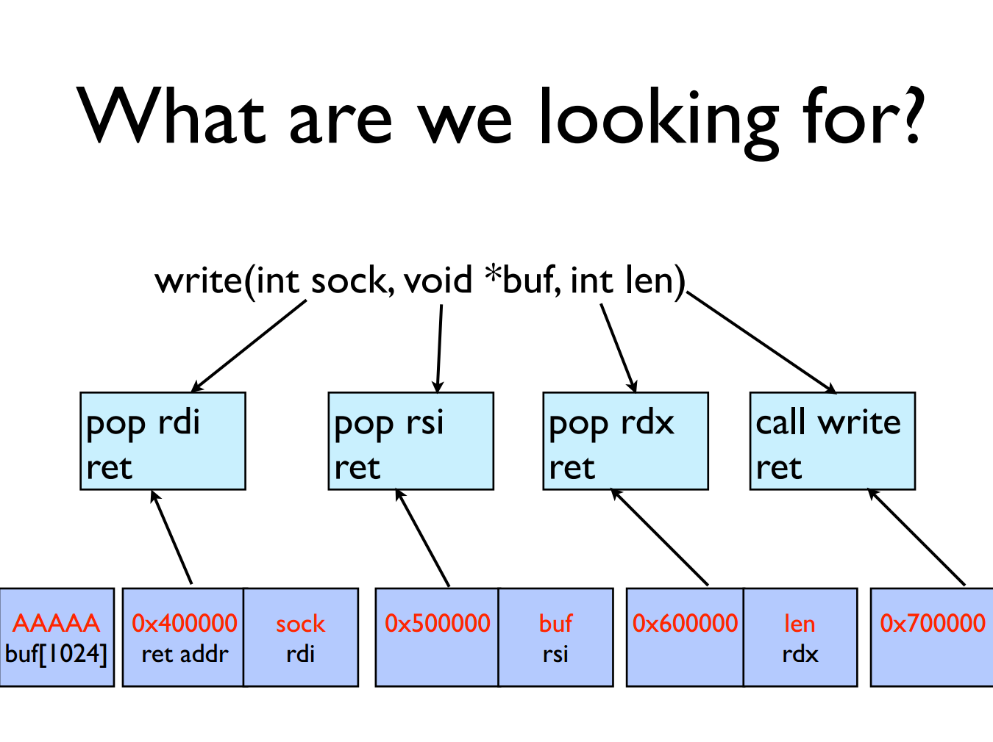

Slide 19
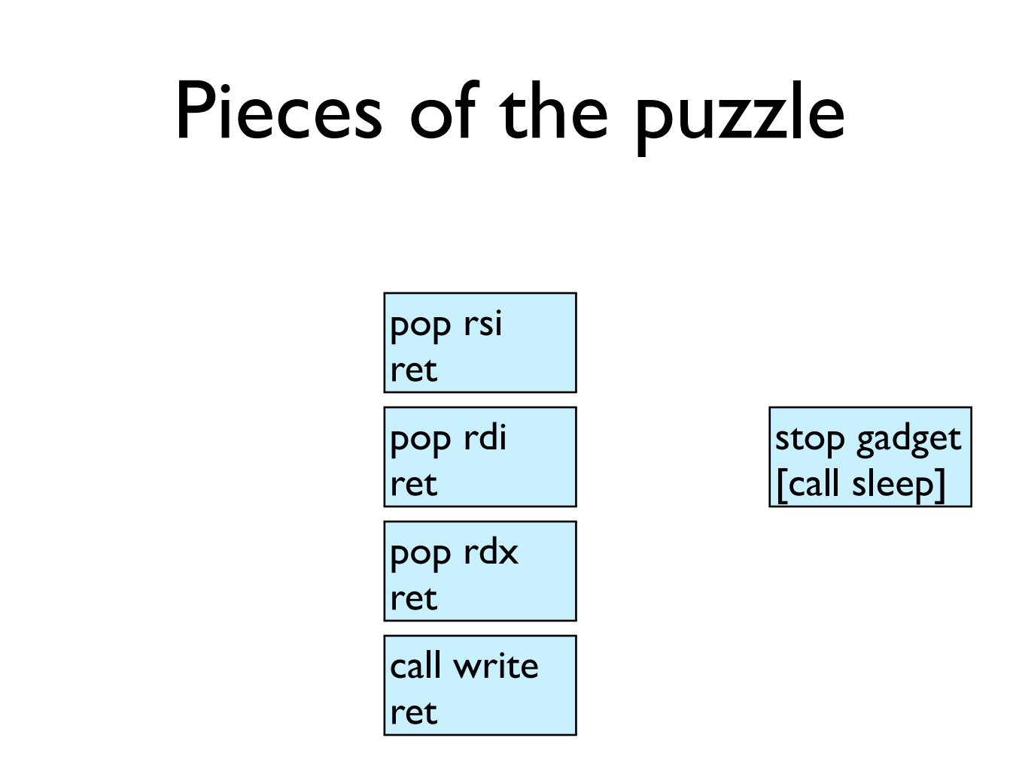

Slide 20
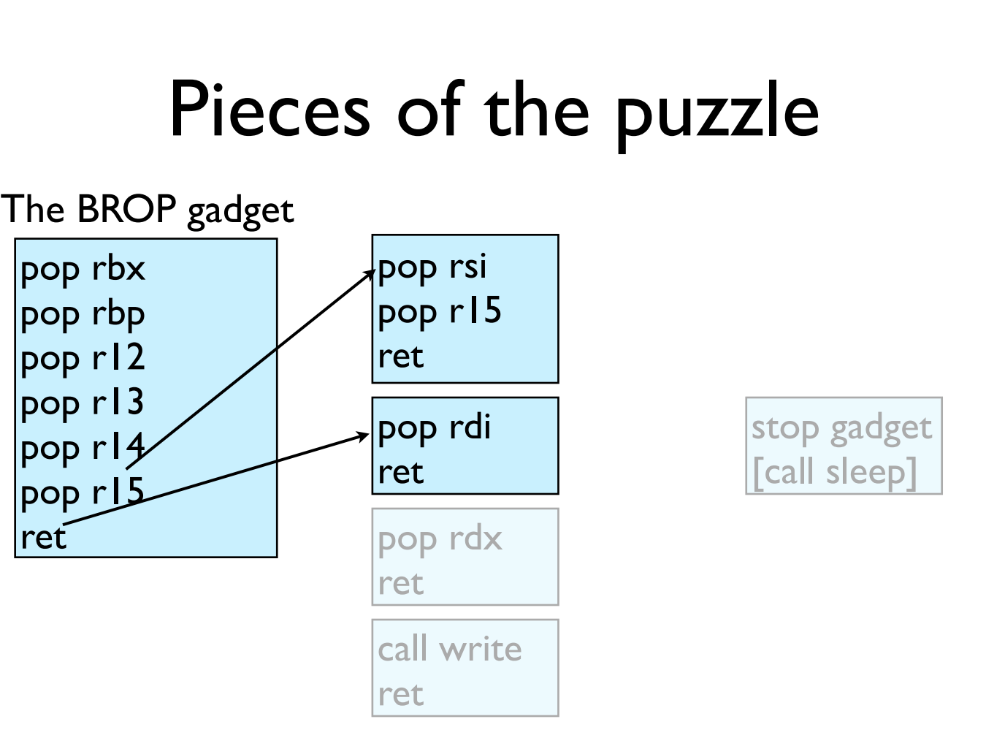

Slide 21
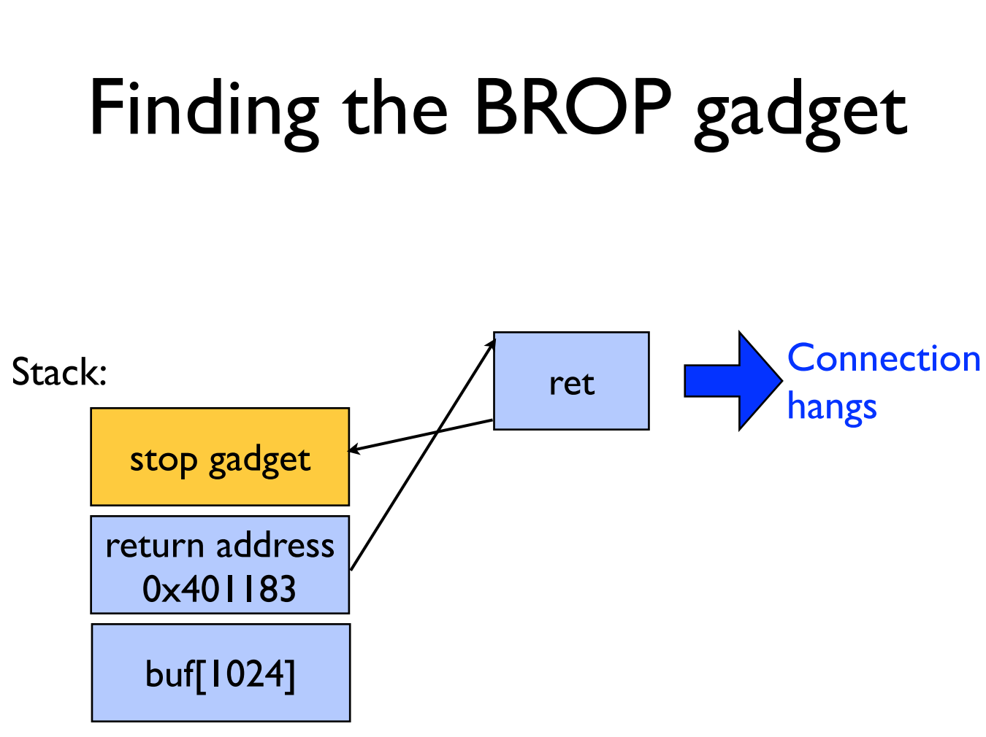

Slide 22
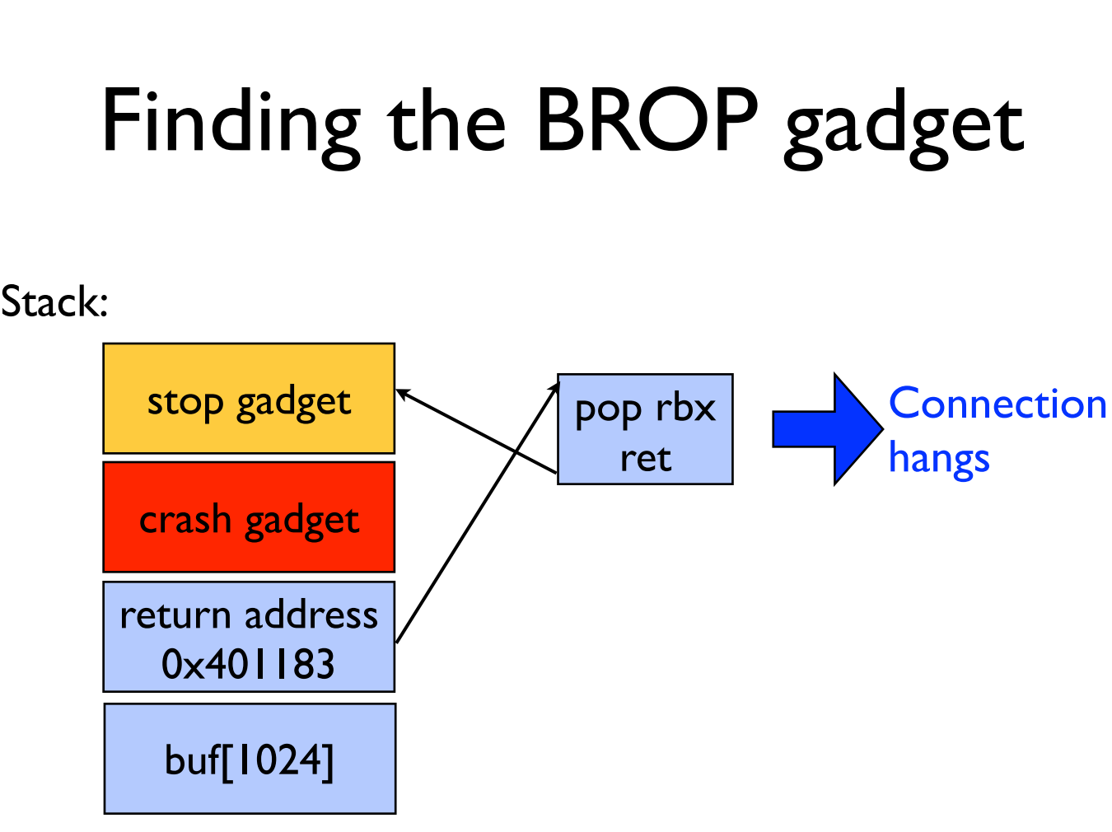

Slide 23
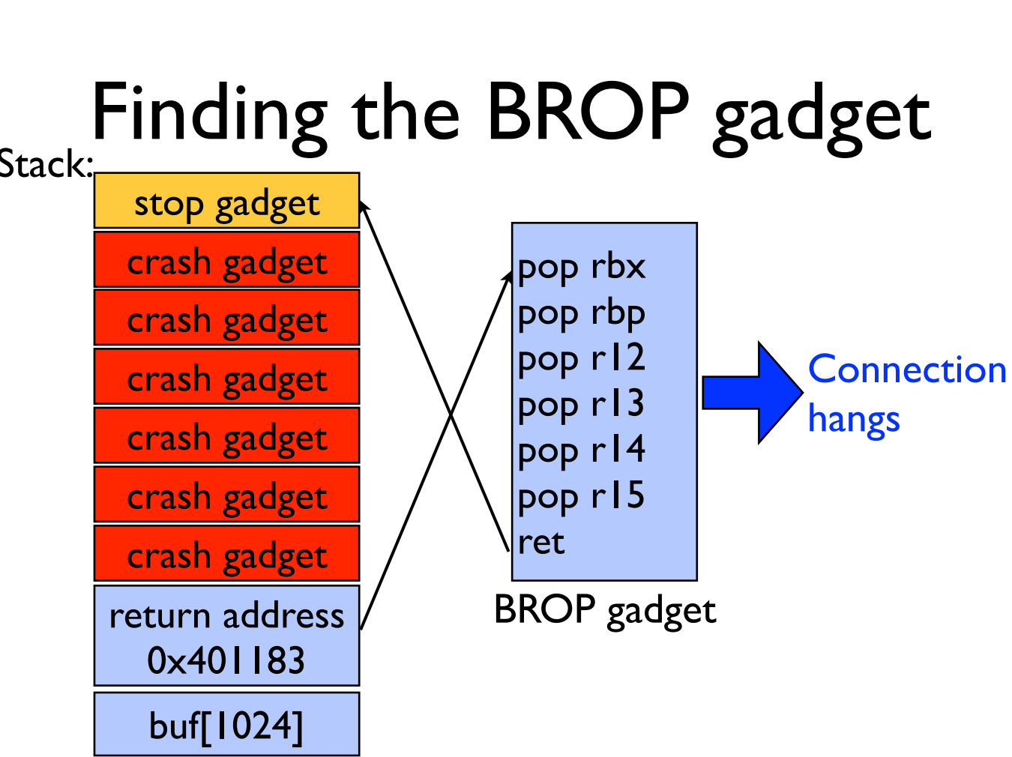

Slide 24
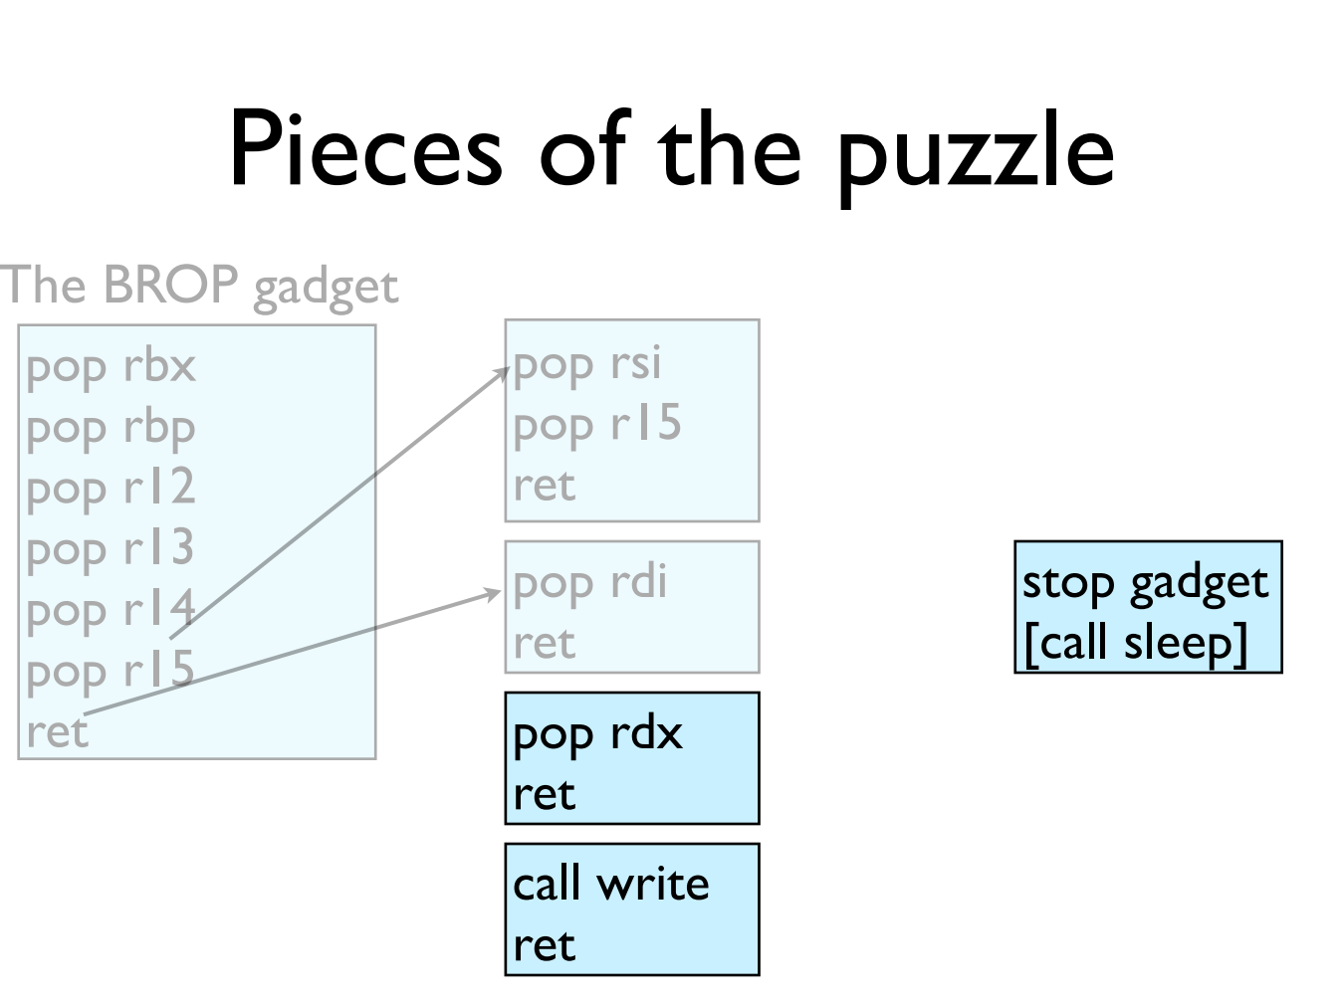

Slide 25
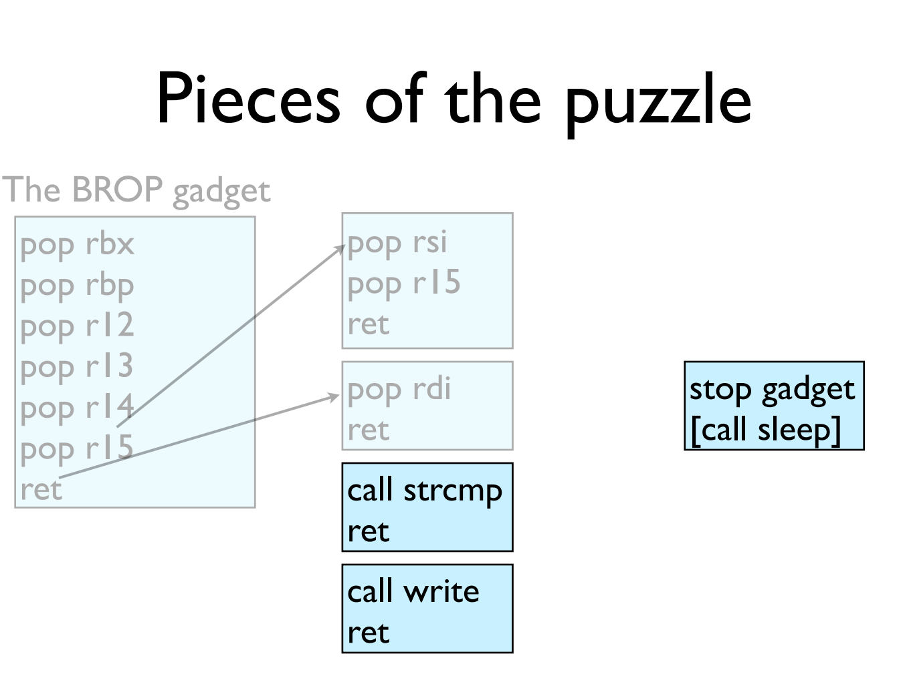

Slide 26
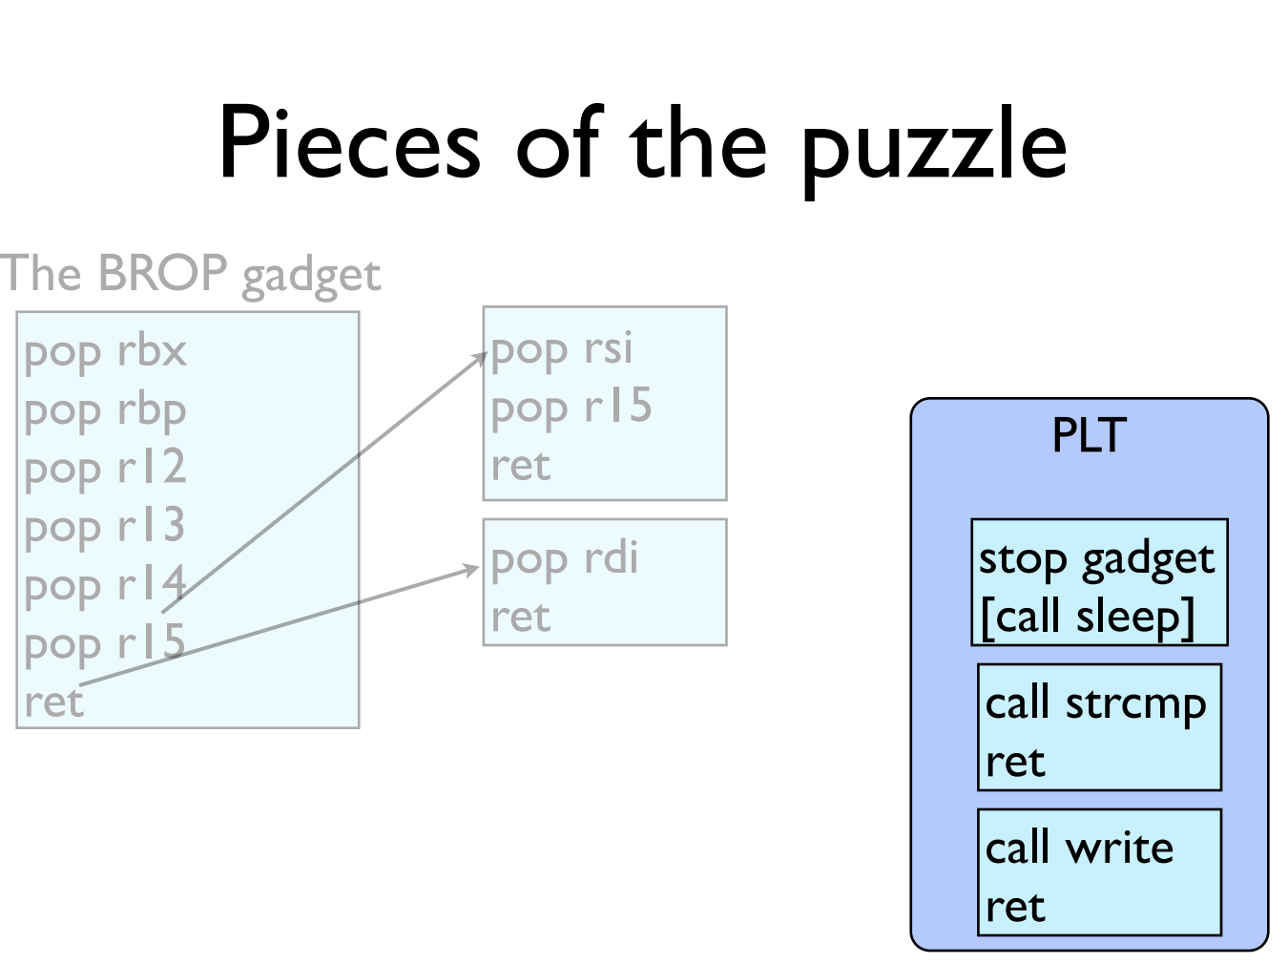

Slide 27
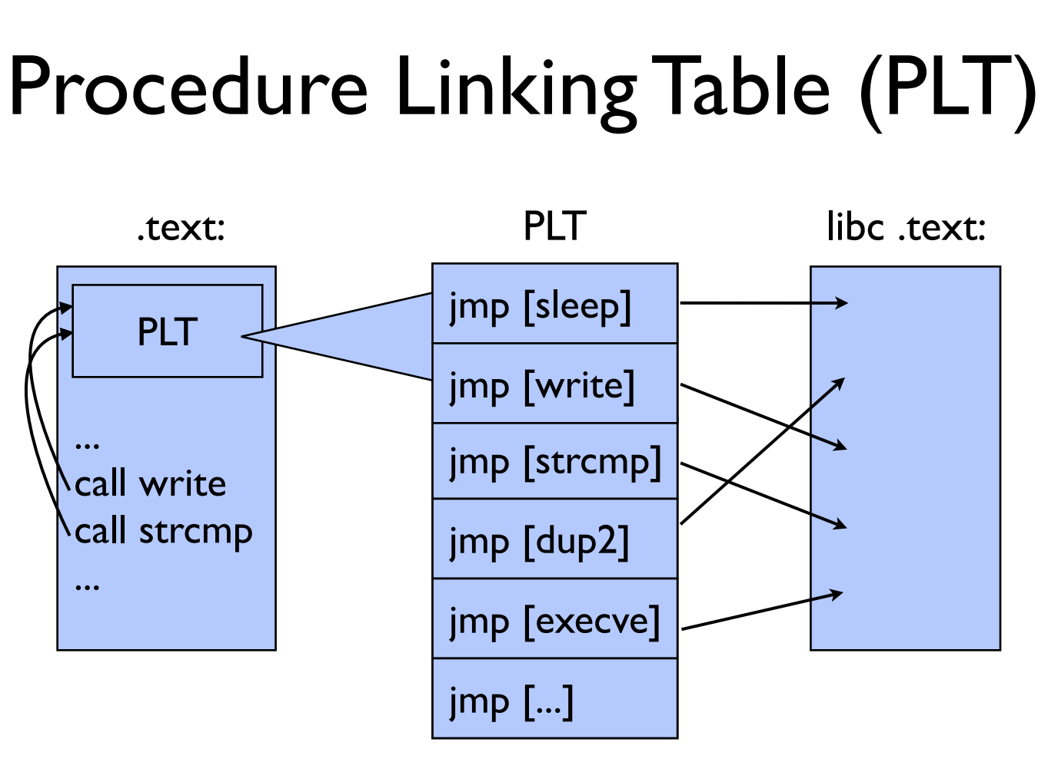

Slide 28
GOT & PLT
Jump to the address that this entry of the GOT contains:
  First time: call to dynamic linker and write the function address to GOT
  Not first time: the GOT already contains the address that points to printf.
PLT
printf() call
Dynamic linker
libc
GOT

Slide 29
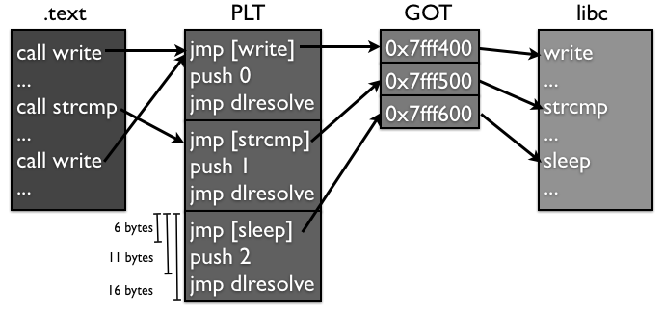
Notes:
另外，大部分的PLT项都不会因为传进来的参数的原因crash，因为它们很多都是系统调用，都会对参数进行检查，如果有错误会返回EFAULT而已，并不会造成进程crash。所以攻击者可以通过下面这个方法找到PLT：如果攻击者发现好多条连续的16个字节对齐的地址都不会造成进程crash，而且这些地址加6得到的地址也不会造成进程crash，那么很有可能这就是某个PLT对应的项了。

Slide 30
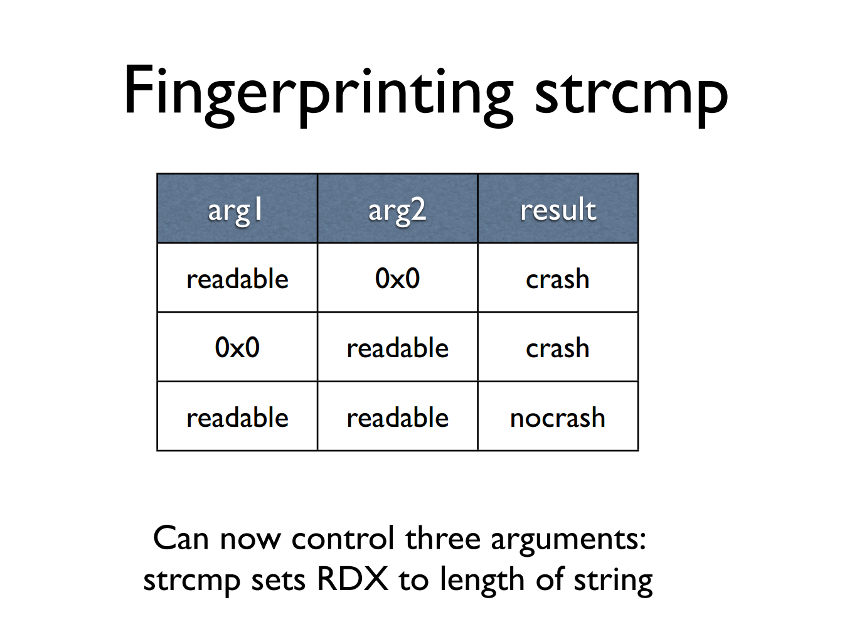

Slide 31
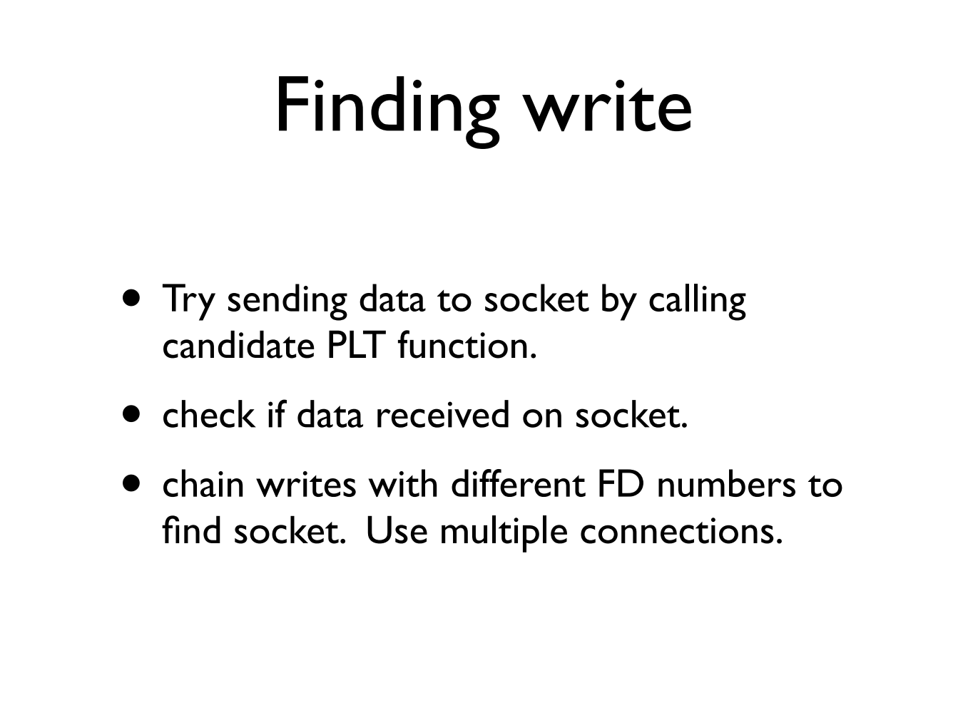
Notes:
1. 同时调用好几次write，把它们串起来，然后传入不同的文件描述符数；2. 同时打开多个连接，然后使用一个相对较大的文件描述符数字，增加匹配的可能性。

Slide 32
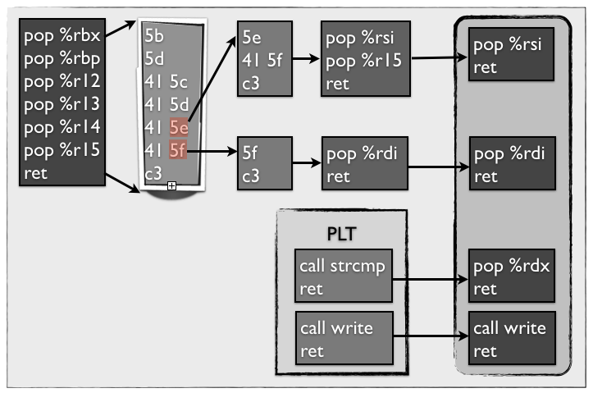

Slide 33
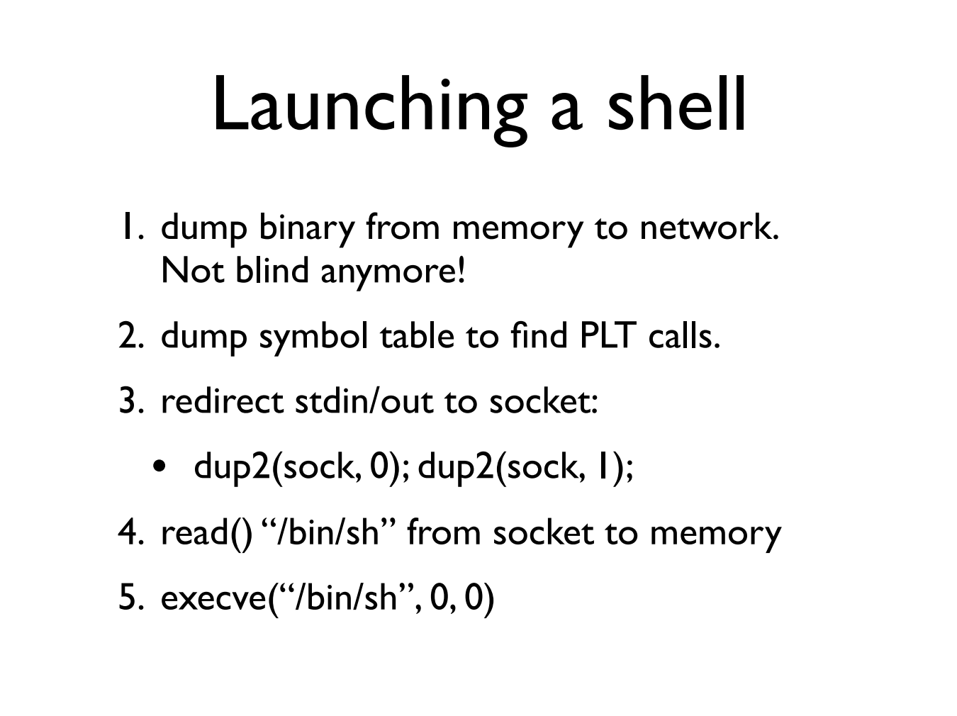

Slide 34
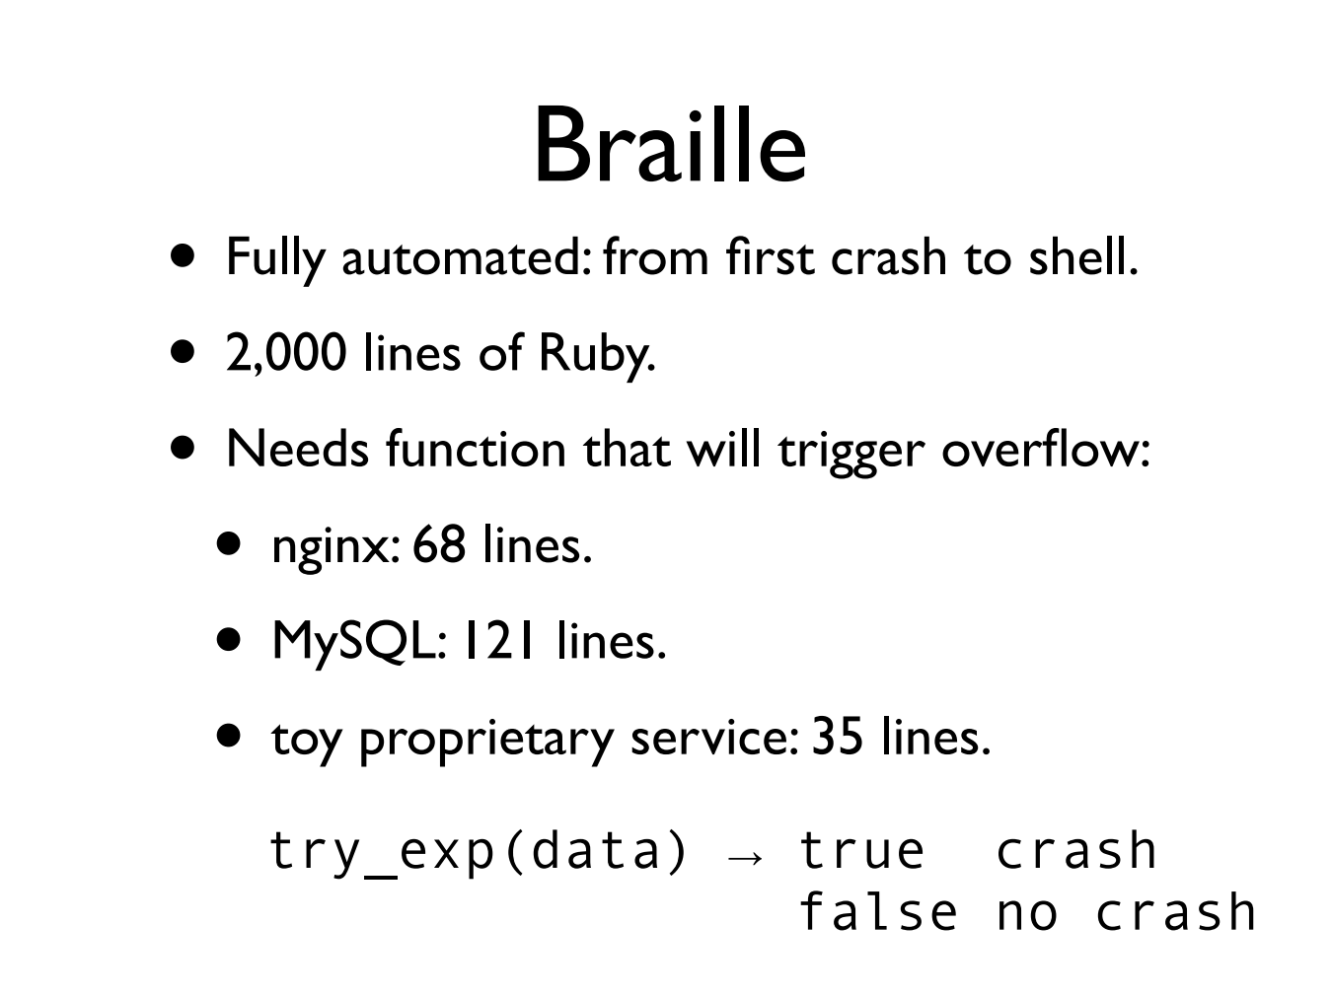

Slide 35
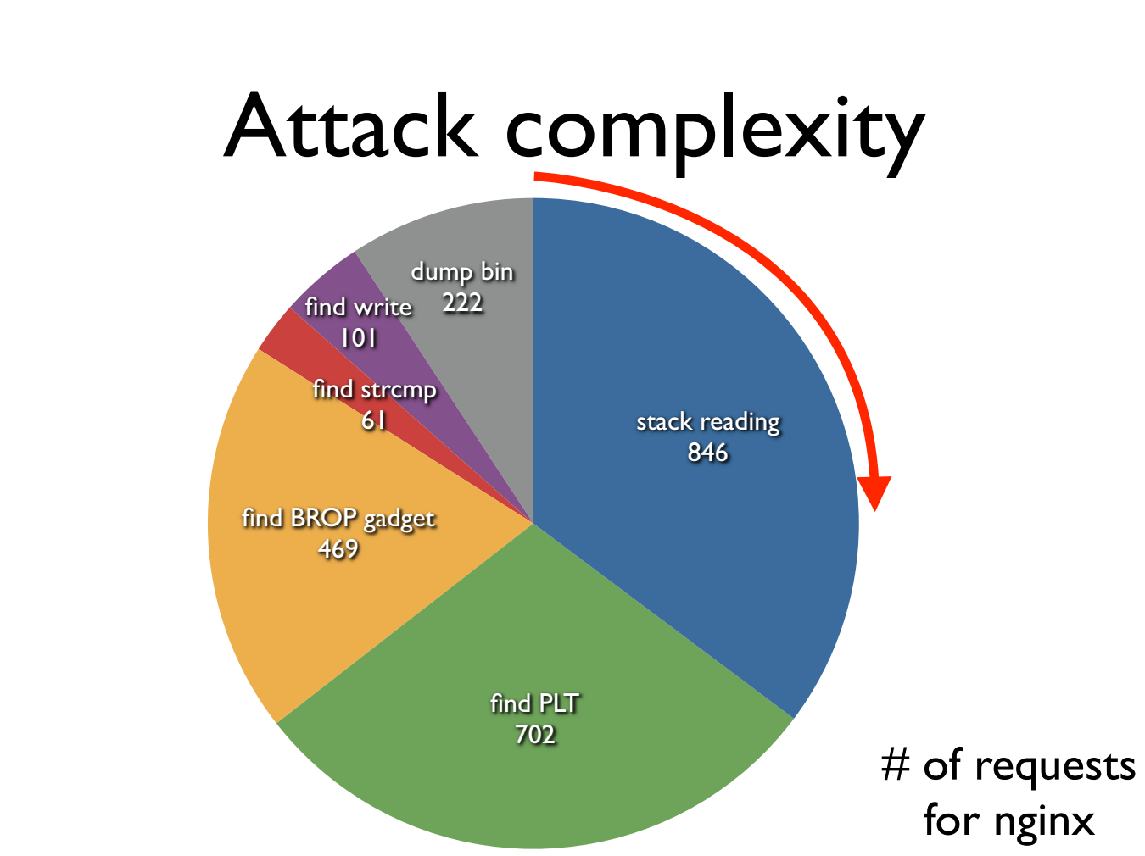

Slide 36
Try It!
http://www.scs.stanford.edu/brop/
More information
  S&P'14 paper: http://www.scs.stanford.edu/brop/bittau-brop.pdf
  Blog: http://drops.wooyun.org/tips/3071

Slide 37
Data Flow Protection

Slide 38
Two Usages of Data Flow Tracking
Usage-1: protect critical data
  E.g., track data to ensure none is leaked
Usage-2: defend against suspicious input data
  E.g., one input data cannot flow to return address!

Slide 39
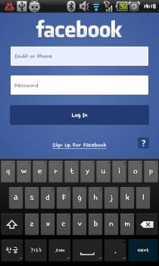
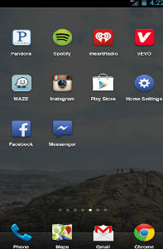
Ways an Attacker Can Steal Your Secrets
KeyLogger: install a KeyLogger/TouchLogger on the phone
Phishing: install a malware and lure the user to enter password
Malicious app
in background,
waiting for the
Facebook app
to launch
Once Facebook app
starts, the malicious
app will get active
and make itself
cover the real UI
Bianchi, Antonio, et al. "What the App is That? Deception and Countermeasures in the Android User Interface.", S&P 2015.
Notes:
Or he can install a malware to lure the user to enter password. A typicall malware will run in background...

Slide 40

Ways an Attacker Can Steal Your Secrets
KeyLogger: install a KeyLogger/TouchLogger on the phone
Phishing: install a malware and lure the user to enter password
MemScan: use rootkit and scan the memory for any plaintext
010100101010101000101010101010101010101010101010010101010101010010101010101010101001010011010101010101010101010001001000000101010010010010
The Samsung memory mapping bug: http://forum.xda-developers.com/showthread.php?t=2048511
Notes:
Or, he can just use rootkit and scan the memory for any plaintext

Slide 41
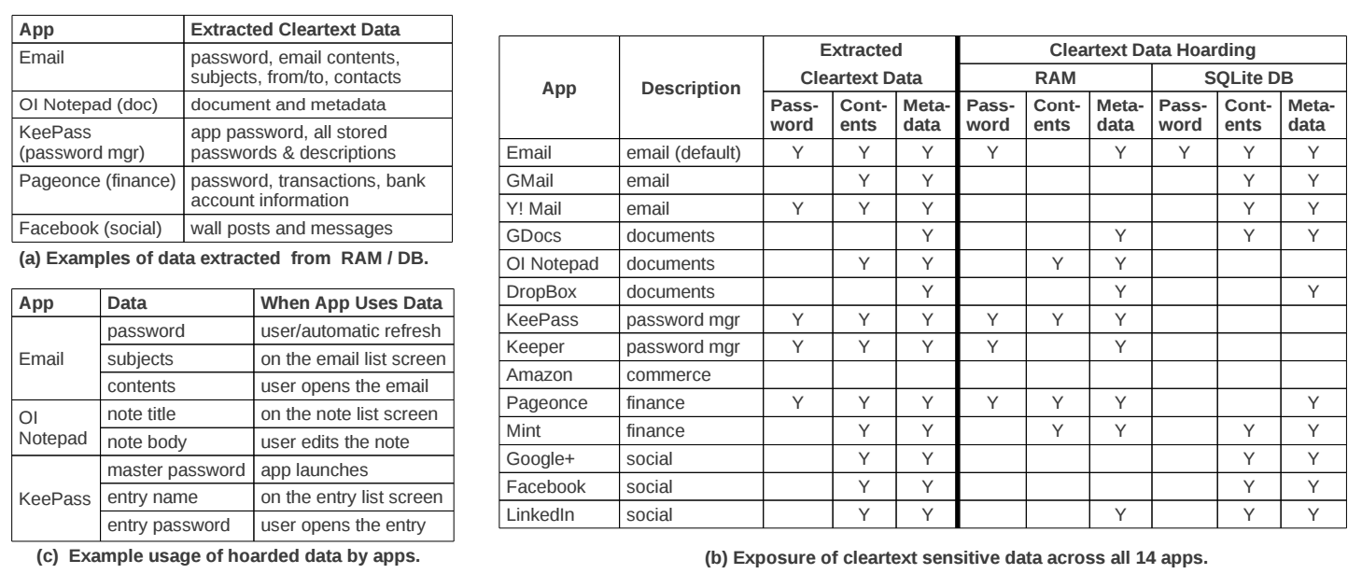
The "Data Residue" Problem
The plaintext of confidential data may exist in memory on a mobile device for a long time
应用对关键数据的保护不够
  引CleanOS的数据
Android's default Email app:
has plaintext of password in RAM 10 minutes after login
Tang, Yang, et al. "CleanOS: Limiting Mobile Data Exposure with Idle Eviction." OSDI. 2012.
Notes:
This attack is simple but effective since the memory does contain many secrets. Here is a table from cleanOS, OSDI'12 paper.
It shows that many popular applications will leave residue of critical data in memory for a long time. For example,
the android's default email app,

Slide 42
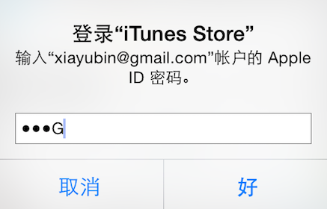
Ways an Attacker Can Steal Your Secrets
KeyLogger: install a KeyLogger/TouchLogger on the phone
Phishing: install a malware and lure the user to enter password
MemScan: use rootkit and scan the memory for any plaintext
ScreenCapture: get information directly from the screen
Jang, Yeongjin, et al. "A11y Attacks: Exploiting Accessibility in Operating Systems." CCS, 2014.
Notes:
The attacker might also steal your password from screen. On iOS system, once you enter a password, the last character will be displayed for a second. If the attacker can access framebuffer or capture the screen, he can get your password

Slide 43
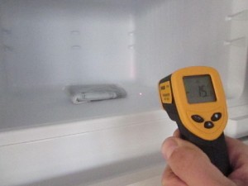
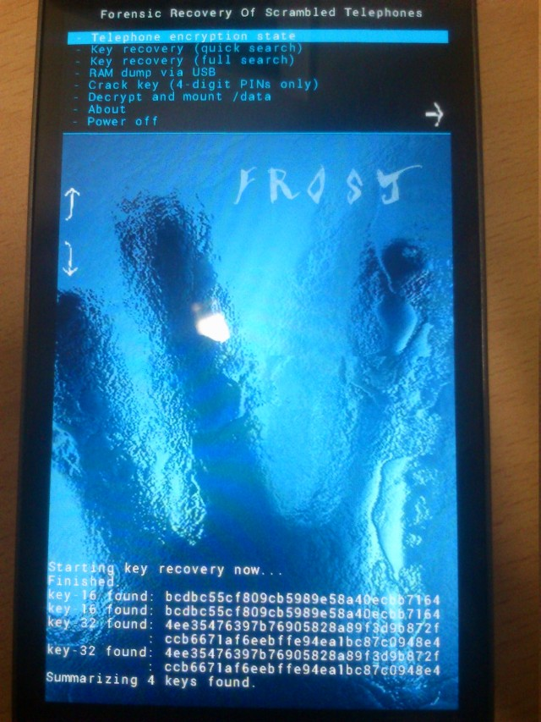
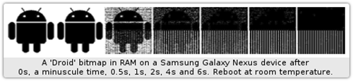
Ways an Attacker Can Steal Your Secrets
KeyLogger: install a KeyLogger/TouchLogger on the phone
Phishing: install a malware and lure the user to enter password
MemScan: using rootkit and scan memory for any plaintext
ScreenCapture: get information directly from the screen
Cold-boot: physically attack that can scan memory to get any plaintext
Müller, Tilo, and Michael Spreitzenbarth. "Frost." Applied Cryptography and Network Security. Springer Berlin Heidelberg, 2013.
Notes:
Cold boot attack is also possible on the mobile device, which just scan the memory to get an plaintext.

Slide 44
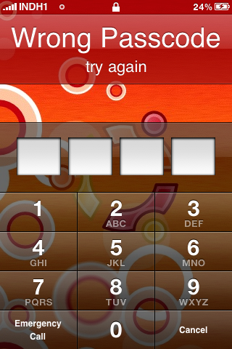
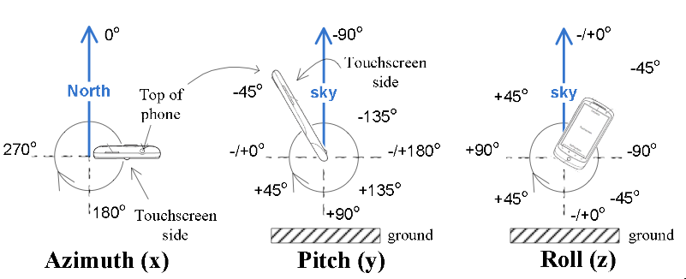
Ways an Attacker Can Steal Your Secrets
KeyLogger: install a KeyLogger/TouchLogger on the phone
Phishing: install a malware and lure the user to enter password
MemScan: using rootkit and scan memory for any plaintext
ScreenCapture: get information directly from the screen
Coldboot: physically scan the memory to get any plaintext
Side-Channel: infer PIN code through motion-detector
Cai, Liang, and Hao Chen. "TouchLogger: Inferring Keystrokes on Touch Screen from Smartphone motion." HotSec. 2011.
Notes:
A even more sophistic attack is to use the motion-detector to guess the user's PIN code, just by learning the relationship between the PIN and phone's inclination when pressing the screen.

Slide 45
Taint Tracking
Data Protection

Slide 46
Data Lifetime
The lifetime of sensitive data should be minimized
  The longer data remains in memory the greater its chances of being leaked to disk
  Swapping, hibernation, VM suspending, core dump, etc.
That's what we called "data exposure"

Slide 47
Tainting: Data Flow Tracking
Apply access policy along the data flow
  E.g., a password cannot be sent to Internet
  E.g., credit card number cannot be sent to other apps
  E.g., untrusted data cannot be executed

Slide 48
Dynamic Taint Analysis
i = get_input();
two = 2;
if(i%2 == 0){
  j = i+two;
  l = j;
} else {
  k = two*two;
  l = k;
}
jmp l;
Example sourced from CMU ECE
  Source
Will show the basic approach of dynamic taint analysis
Two concrete executions will be presented
Goal: evaluate whether control can be hijacked by [malicious] user input

Slide 49
Dynamic Taint Analysis
i = get_input();
two = 2;
if(i%2 == 0){
  j = i+two;
  l = j;
} else {
  k = two*two;
  l = k;
}
jmp l;
Variable | Value | Taint Status

Slide 50
Dynamic Taint Analysis
i = get_input();
two = 2;
if(i%2 == 0){
  j = i+two;
  l = j;
} else {
  k = two*two;
  l = k;
}
jmp l;
Variable | Value | Taint Status
i | 6 | true

Slide 51
Dynamic Taint Analysis
i = get_input();
two = 2;
if(i%2 == 0){
  j = i+two;
  l = j;
} else {
  k = two*two;
  l = k;
}
jmp l;
Variable | Value | Taint Status
i | 6 | true
two | 2 | false

Slide 52
Dynamic Taint Analysis
i = get_input();
two = 2;
if(i%2 == 0){
  j = i+two;
  l = j;
} else {
  k = two*two;
  l = k;
}
jmp l;
Variable | Value | Taint Status
i | 6 | true
two | 2 | false
j | 8 | true

Slide 53
Dynamic Taint Analysis
i = get_input();
two = 2;
if(i%2 == 0){
  j = i+two;
  l = j;
} else {
  k = two*two;
  l = k;
}
jmp l;
Variable | Value | Taint Status
i | 6 | true
two | 2 | false
j | 8 | true
l | 8 | true
Notes:
In this case, the taint analysis would show that an attack is possible. Notice, however, that we don't know exactly how variable L is tainted by variable I as we do in a fully symbolic execution—we only know that the two variables are related. However, computing a fully symbolic execution is often intractable, thus giving dynamic taint analysis some merits as a higher-performance technique (in terms of computational efficiency).

Slide 54
Dynamic Taint Analysis
i = get_input();
two = 2;
if(i%2 == 0){
  j = i+two;
  l = j;
} else {
  k = two*two;
  l = k;
}
jmp l;
Variable | Value | Taint Status

Slide 55
Dynamic Taint Analysis
i = get_input();
two = 2;
if(i%2 == 0){
  j = i+two;
  l = j;
} else {
  k = two*two;
  l = k;
}
jmp l;
Variable | Value | Taint Status
i | 7 | true

Slide 56
Dynamic Taint Analysis
i = get_input();
two = 2;
if(i%2 == 0){
  j = i+two;
  l = j;
} else {
  k = two*two;
  l = k;
}
jmp l;
Variable | Value | Taint Status
i | 7 | true
two | 2 | false

Slide 57
Dynamic Taint Analysis
i = get_input();
two = 2;
if(i%2 == 0){
  j = i+two;
  l = j;
} else {
  k = two*two;
  l = k;
}
jmp l;
Variable | Value | Taint Status
i | 7 | true
two | 2 | false
k | 4 | false

Slide 58
Dynamic Taint Analysis
i = get_input();
two = 2;
if(i%2 == 0){
  j = i+two;
  l = j;
} else {
  k = two*two;
  l = k;
}
jmp l;
Variable | Value | Taint Status
i | 7 | true
two | 2 | false
k | 4 | false
l | 4 | false
Notes:
In this case, the taint analysis would show that an attack is not possible.

Slide 59
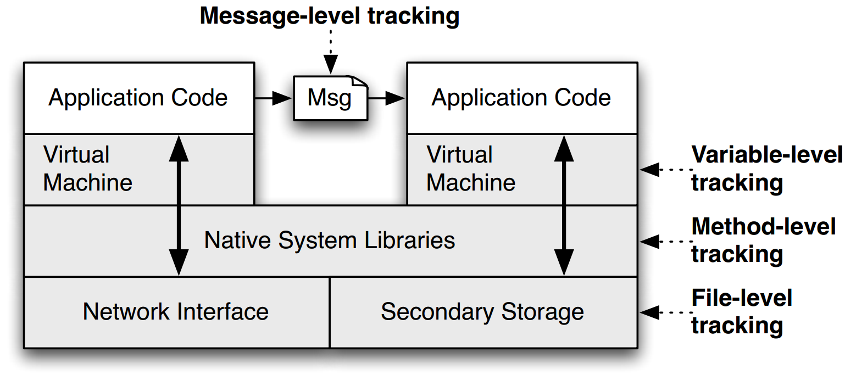
TaintDroid
Notes:
This is a figure from the conference paper describing TaintDroid. It shows where, at a high level, the various kinds of taint analysis are done. There are 4 "granularities" of taint analysis used in TaintDroid, including message-level, variable-level, method-level, and file-level.

Slide 60
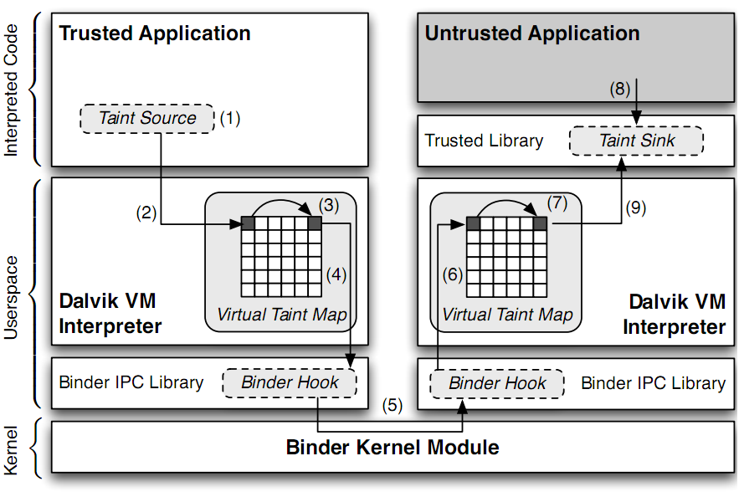
TaintDroid Data Flow
Notes:
Sensitive information is ﬁrst identiﬁed at a taint source, where a taint marking indicating the information type is assigned. Dynamic taint
analysis tracks how labeled data impacts other data in a way that might leak the original sensitive information.
Finally, the impacted data is identiﬁed before it leaves the system at a taint sink (usually the network interface).
possible false positive

Slide 61
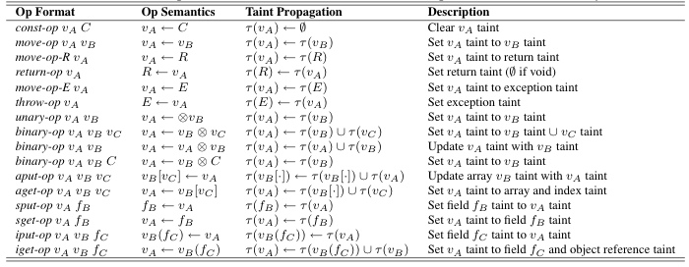
Taint Propagation

Slide 62

Defending Malicious Input

Slide 63
Two Usages of Data Flow Tracking
Usage-1: protect critical data
  E.g., track data to ensure none is leaked
Usage-2: defend against suspicious input data
  E.g., one input data cannot flow to return address!

Slide 64
How does a Hacker Search a Bug?
Step-0: Chose a library (open-source, of course)
  Let's try ffmpeg, which is used in Chrome, VLC, Mplayer...
  There are also rumors that YouTube uses it for conversion
Step-1: List the demuxers of ffmpeg
Step-2: Identify the input data
Step-3: Trace the input data

Slide 65
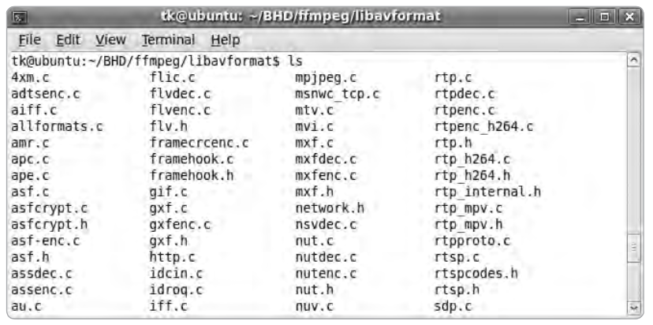
Step-1: List the Demuxers of FFmpeg

Slide 66

Step-2: Identify the Input Data
demuxername_read_header()
  Most demuxers declear a function called it
  Takes a parameter of type AVFormatContext
  This function initializes a pointer:
  Many different get_something() are used to extract pb data
    E.g., get_le32(), get_buffer()
  Conclusion: pb is a pointer to the input data of media files

Slide 67
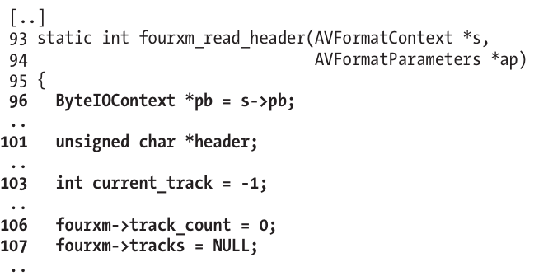
Step-3: Trace the Input Data
Start to read the first demuxer: libavformat/4xm.c

Slide 68
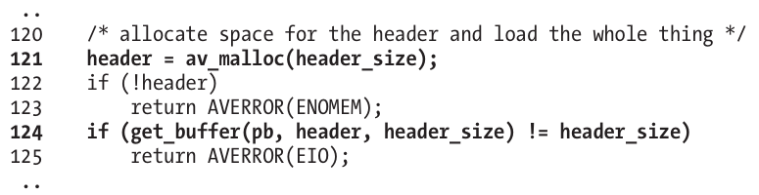
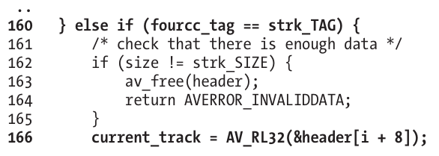
int
unsigned int

Slide 69
Step-3: Trace the Input Data
Supplying a value >= 0x80000000 for current_track causes a change in sign that results in current_track being interpreted as negative
The if statement in line 167 will always return FALSE
Thus, the buffer allocation in line 171 will never be reached

Slide 70
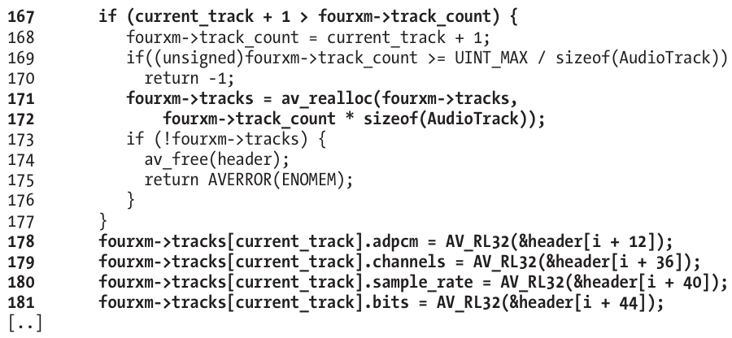
Step-3: Trace the Input Data

Slide 71
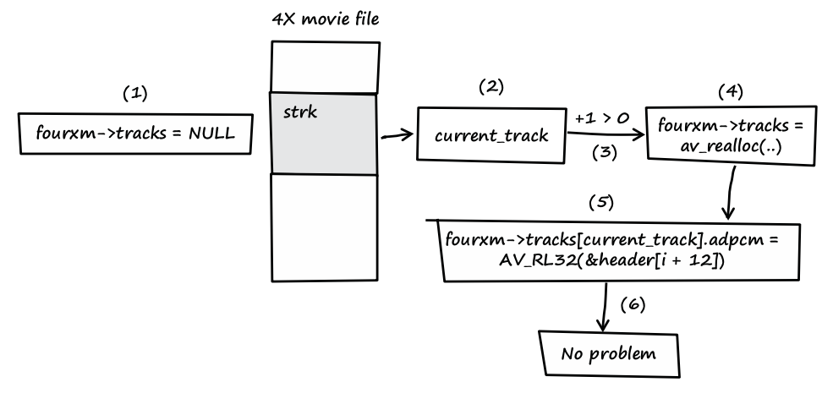
Step-3: Trace the Input Data
Notes:
fourxm->tracks is initialized with NULL (see line 107).
If the processed media file contains a strk chunk, the value of current_track is extracted from the user-controlled data of the chunk (see line 166).
If the value of current_track + 1 is greater than zero, a heap buffer is allocated.
The heap buffer pointed to by fourxm->tracks is allocated (see lines 171 and 172).
Data from the media file is copied into the heap buffer, while current_track is used as an array index into the buffer (see lines 178–181).
When this behavior occurs, there is no security problem.

Slide 72
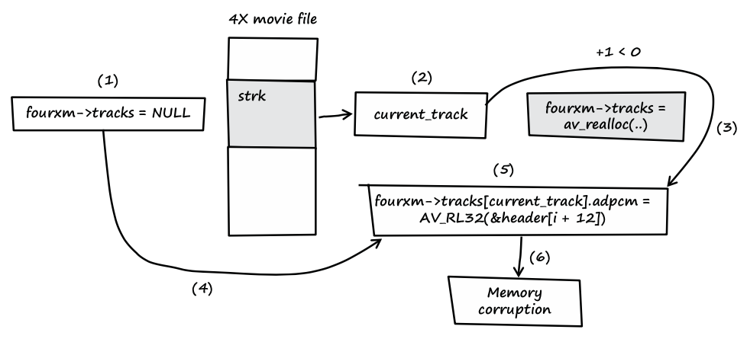
Step-3: Trace the Input Data
Notes:
fourxm->tracks is initialized with NULL (see line 107).
If the processed media file contains a strk chunk, the value of current_track is extracted from the user-controlled data of the chunk (see line 166).
If the value of current_track + 1 is less than zero, the heap buffer isn't allocated.
fourxm->tracks still points to memory address NULL.
The resulting NULL pointer is then dereferenced by the user- controlled value of current_track, and four 32-bit values of user- controlled data are assigned to the dereferenced locations (see lines 178–181).
Four user-controlled memory locations can be overwritten with four user-controlled data bytes each.

Slide 73
Question
How can we use taint tracking to find such bugs?

Slide 74
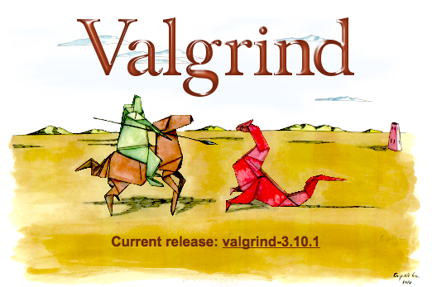
TaintCheck: Basic Ideas
Program execution normally derived
from trusted sources, not attacker input
Mark all input data to the computer as "tainted" (e.g., network, stdin, etc.)
Monitor program execution and track how tainted data propagates (follow bytes, arithmetic operations, jump addresses, etc.)
Detect when tainted data is used in dangerous ways

Slide 75
Add Taint Checking code
TaintCheck first runs the code through an emulation environment (Valgrind) and adds instructions to monitor tainted memory
X86 instructions
UCode
Binary re-writer
Taint Check
X86 instructions
UCode
Dynamic taint analysis

Slide 76

TaintCheck Detection Modules
TaintSeed: Mark untrusted data as tainted
TaintTracker: Track each instruction, determine if result is tainted
TaintAssert: Check is tainted data is used dangerously

Slide 77
Performance Evaluation – CPU Bound Process
Hardware: 2.00 GHz Pentium 4, 512 MB RAM, RedHat 8.0
Application: bzip2(15mb)
  Normal runtime 8.2s
  Valgrind nullgrind skin runtime: 25.6s (3.1x)
  Memcheck runtime: 109s (13.3x)
  TaintCheck runtime: 305s (37.2x)

Slide 78

Performance Overhead of Apache
A more representative case, network and I/O
Better performance

Slide 79
Secure Channel

Slide 80

Encryption Properties

Slide 81
has k
has k
k=key
m=message
Alice
Bob
c = encrypt(k, m)
h = MAC(k, m)
c | h
m = decrypt(k, c)
MAC(k, m) == h ?

Slide 82
has k
has k
Alice
Eve
Bob
c = encrypt(k, m)
h = MAC(k, m)
c | h
m = decrypt(k, c)
MAC(k, m) == h ?
c | h
Problem: replay attacks
(adversary could intercept a message, re-send it at a later time)
c | h

Slide 83
has k
has k
Alice
Bob
c = encrypt(k, m | seq)
h = MAC(k, m | seq)
c | h
m | seq = decrypt(k, c)
MAC(k, m | seq) == h ?

Slide 84
has k
has k
Alice
Eve
Bob
c = encrypt(k, m | seq)
h = MAC(k, m | seq)
c | h
m | seq = decrypt(k, c)
MAC(k, m | seq) == h ?
c | h
if reuse seq
(e.g., date)
problem: reflection attacks
(adversary could intercept a message, re-send it later in the opposite direction)
Notes:
But if receiver is also sending to the sender (i.e., if they're both sending), the receiver might use that sequence number. So adversary could replay in the other direction (a "reflection" attack) - Solution: Use different keys in each direction

Slide 85
has k_{a} & k_{b}
has k_{a} & k_{b}
Alice
Bob
c_{a} = encrypt(k_{a}, m_{a} | seq_{a})
h_{a} = MAC(k_{a}, m_{a} | seq_{a})
c_{a} | h_{a}
m_{a} | seq_{a} = decrypt(k_{a}, c_{a})
MAC(k_{a}, m_{a} | seq_{a}) == h_{a} ?
c_{b} = encrypt(k_{b}, m_{b} | seq_{b})
h_{b} = MAC(k_{b}, m_{b} | seq_{b})
c_{b} | h_{b}
m_{b} | seq_{b} = decrypt(k_{b}, c_{b})
MAC(k_{b}, m_{b} | seq_{b}) == h_{b} ?

Slide 86

Diffie-Hellman
Key Exchange
(g^{b} mod p)ª mod p = g^{ab} mod p = (gª mod p)^{b} mod p
Notes:
g^i mod p ≠ g^j mod p （p为素数），其中i≠j且i, j介于1至(p-1)之间，则g为p的原根

Slide 87

Diffie-Hellman Key Exchange & Man-in-the-Middle

Slide 88

RSA Algorithm

Slide 89
Public Key Distribution
1. Alice remembers the key she used last time
  Easy to implement
  Effective against subsequent man-in-the-middle attacks
  Doesn't protect against MITM attacks the first time around
  Doesn't allow parties to change keys
2. Consult some authority that knows everyone's public key
  Does not scale (client asks for a PK for every new name)
  Alice needs server's public key beforehand

Slide 90
Public Key Distribution
3. Authority, but pre-compute responses
  Authority creates signed messages: {Bob, PK_bob}_{SK_as}
  Anyone can verify the authority signed this message, given PK_as
  When Alice wants to talk to Bob, she needs a signed message from the authority, but it doesn't matter where this message comes from as long as the signature checks out
    I.e., Alice could retrieve the message from a different server
  This signed message is a certificate
  More scalable

Slide 91
Review: Two Types of Encryption
Symmetric key encryption
  Single key (symmetric) is shared between parties, kept secret from everyone else
  Ciphertext = (M)^K
Asymmetric key encryption
  Keys come in pairs, public and private
  Secret: (M)^K-public
  Authentic: (M)^K-private

Slide 92
Questions on Certificate Authorities
Who should run the certificate authority?
How does the browser get this list of CAs?
  Generally they come with the browser
How does the CA build its table of names <-> public keys?
  Have to agree on how to name principals, and
  Need a mechanism to check that a key corresponds to a name
What if a CA makes a mistake?
  Need a way to revoke certificates: Expiration date? Not useful for immediate problems
  Publish certificate revocation list? Works in theory, not as well in practice
  Query online server to check certificate freshness? Not a bad idea
Notes:
Alternative: avoid CAs by using public keys as names (protocols: SPKI/SDSI)
Works well for names that users do not have to remember/enter

Slide 93

Notes:
pre-master-key is a random number
PRF: pseudo random function
Master key is a 48-byte sequence
https://crypto.stackexchange.com/questions/1139/what-is-the-purpose-of-four-different-secrets-shared-by-client-and-server-in-ssl

